Slide 1
E-Commerce Market Basket Analysis
By,
Rutanshu Desai
MS, Systems Engineering Management (Business Analytics)
The University of Texas at Dallas

Slide 2
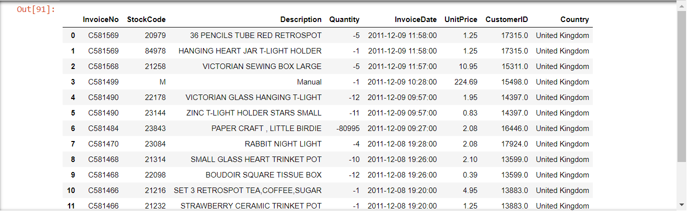
Raw Data

Slide 3
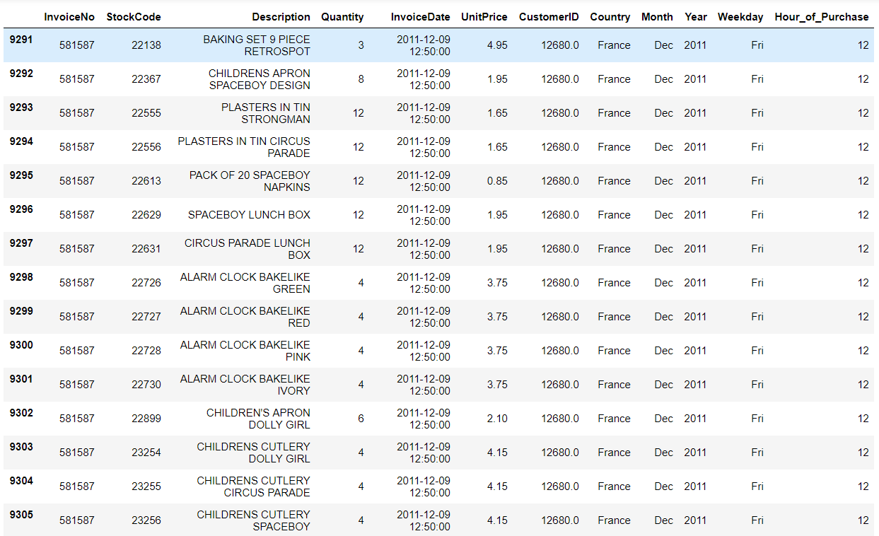
Cleaned Data
The dataset contains 529,733 transactions.
For details on data cleaning, visit my GitHub account -

Slide 4
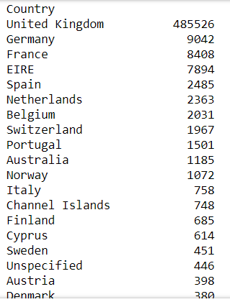
Country information
As we can see in the table, most of our transactions are made from United Kingdom and is our major market in the Europe.
It is then followed by Germany, France and Ireland.

Slide 5
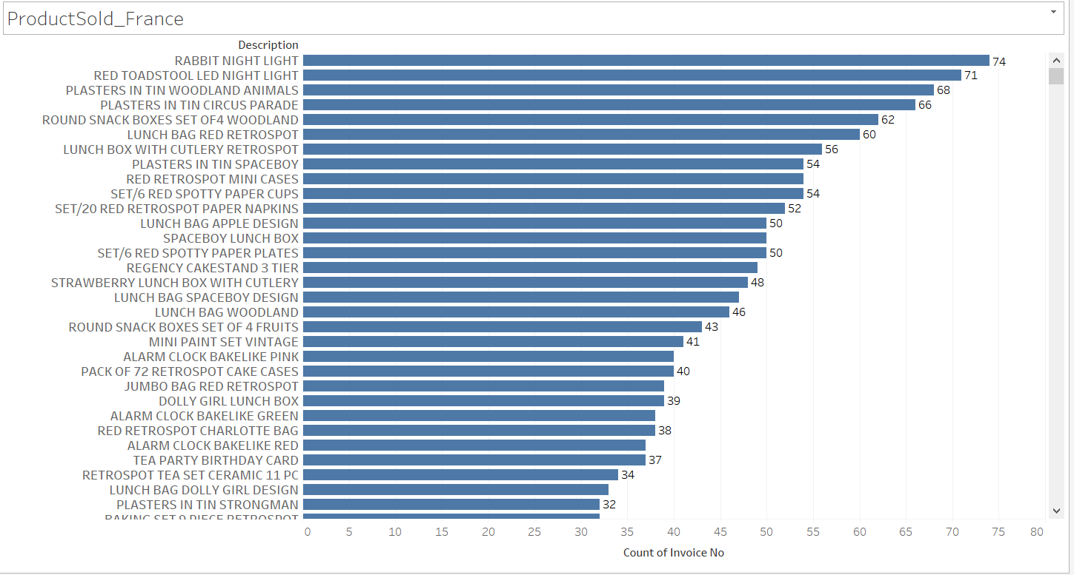
Analysis on France
In the above graph we observe the highest selling products in France.

Slide 6
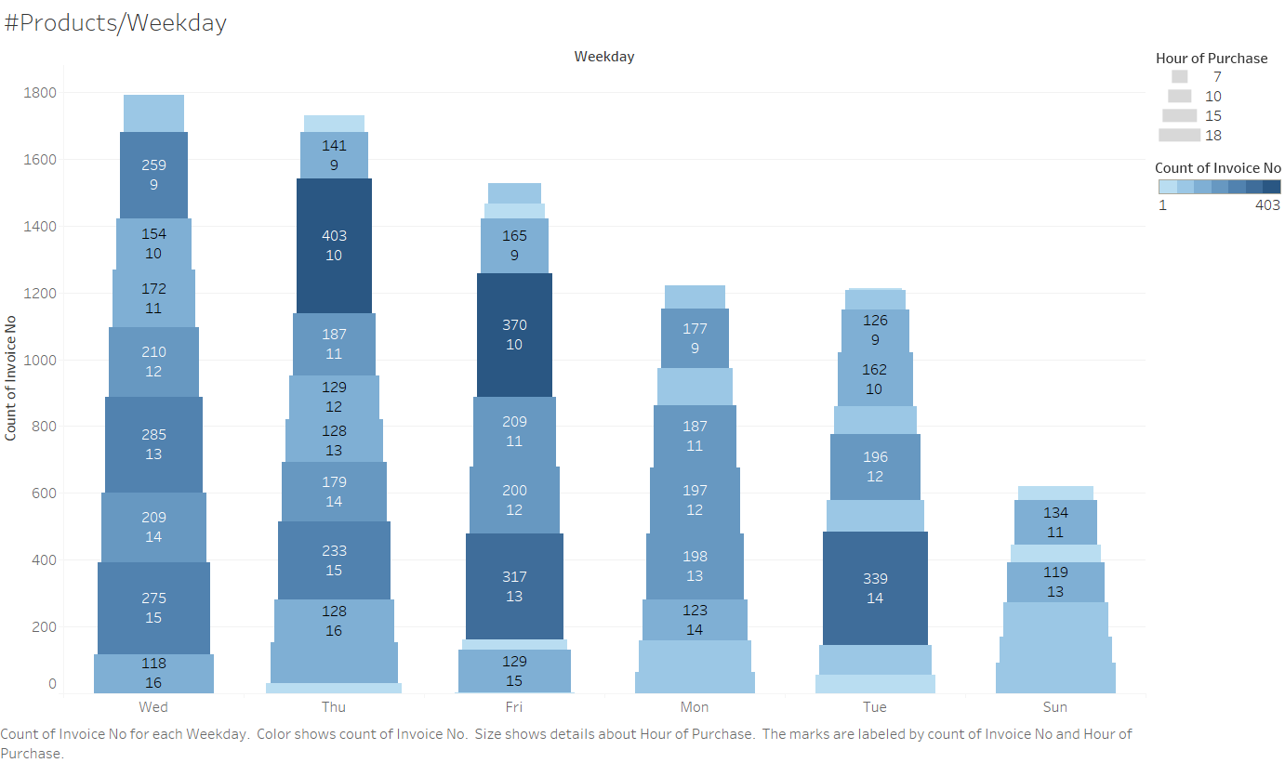
Analysis on France
In the above heatmap, we observe that maximum customers are at 10 am on Thursday and Friday. Sunday has the minimum customers, so may be an offer on Sunday might boost sales on that day.

Slide 7
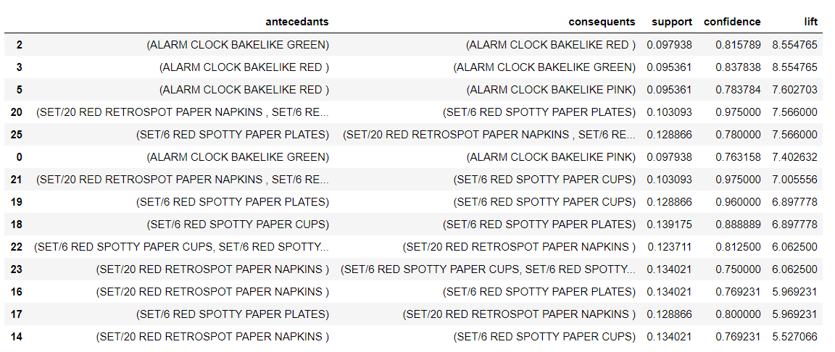
Analysis on France
Market Basket Analysis
For details on codes for the analysis, visit my GitHub account -

Slide 8
Analysis on France
As we can see for rules in RuleID = 25 (previous slide) as well as few others, the trend of buying Paper plates, paper cups and paper napkins is quite often. And this is intuitive enough that people would tend to buy a whole set of disposable items.
The support of [SpottyPaperPlates => (SpottyPaperCups, SpottyPaperNapkins)] is 12.88% [~50/392]. This shows that this combination of purchasing is done 50 times out of total 392 total invoices in France.
The Confidence in the rule, i.e., the probability of purchasing (Cups, Napkins) after a prior purchase of (Plates) made is 0.78.
LIFT is the overall metric that summarizes all the metrics and provides a single number which indicates the importance of the rule. Mathematically speaking, it shows the Statistical Dependence/Independence of the item sets. A lift of 1 shows that the item sets are independent and buying antecedent (Plates) item does not affect in buying the consequent (Cups, Napkins) and the consequent purchase is just random. A lift greater than 1, shows statistical dependency and so purchase of antecedent aids in puchasing of consequent.
LIFT = [CONFIDENCE IN THE RULE] / [SUPPORT OF THE CONSEQUENT]

Slide 9
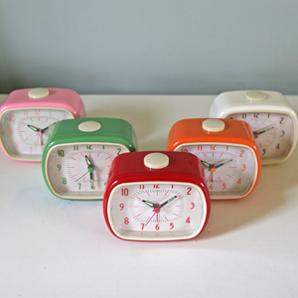
Analysis on France
Also there is some trend in buying different colors of alarm clocks. People of France tend to buy a set of alarm clocks of different colors. Most highly purchased colors are [Red, Green, Pink].
Thus we can give a combo offer which would lead to further sales of clock. Also other colors might be combined for an offer and it seems that people would buy other colors too upon an offer.
Considering the RuleID: 2,
[GreenClock => RedClock]
Support = 9.69% [38/392]
Confidence (probability of buying Red once Green is purchased) = 0.81
Lift = 8.64

Slide 10
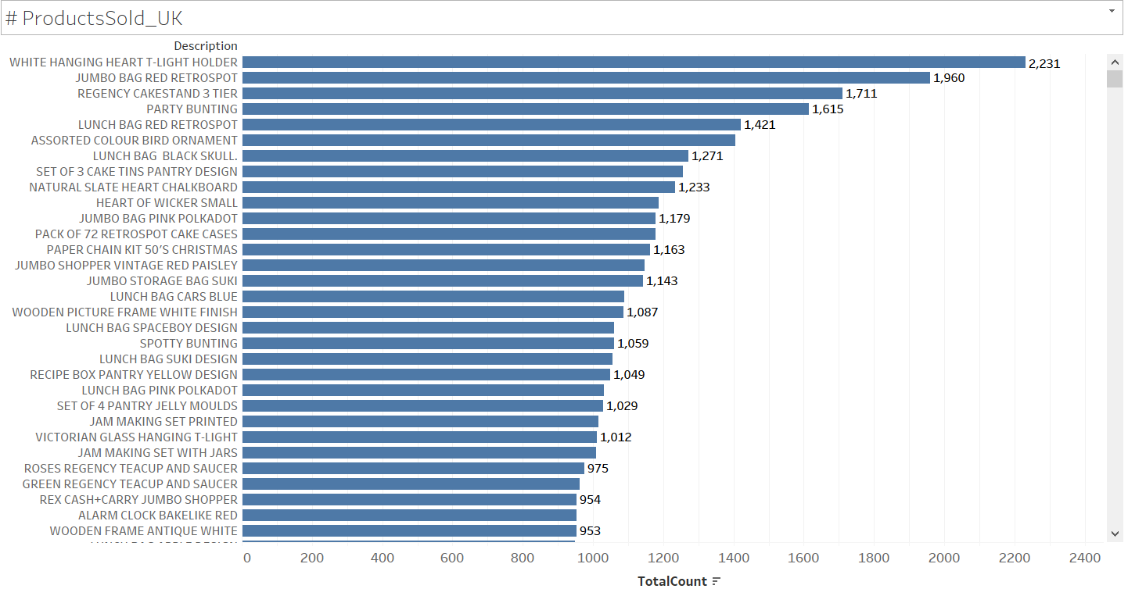
Analysis on United Kingdom
In the above graph we observe the highest selling products in the UK.

Slide 11
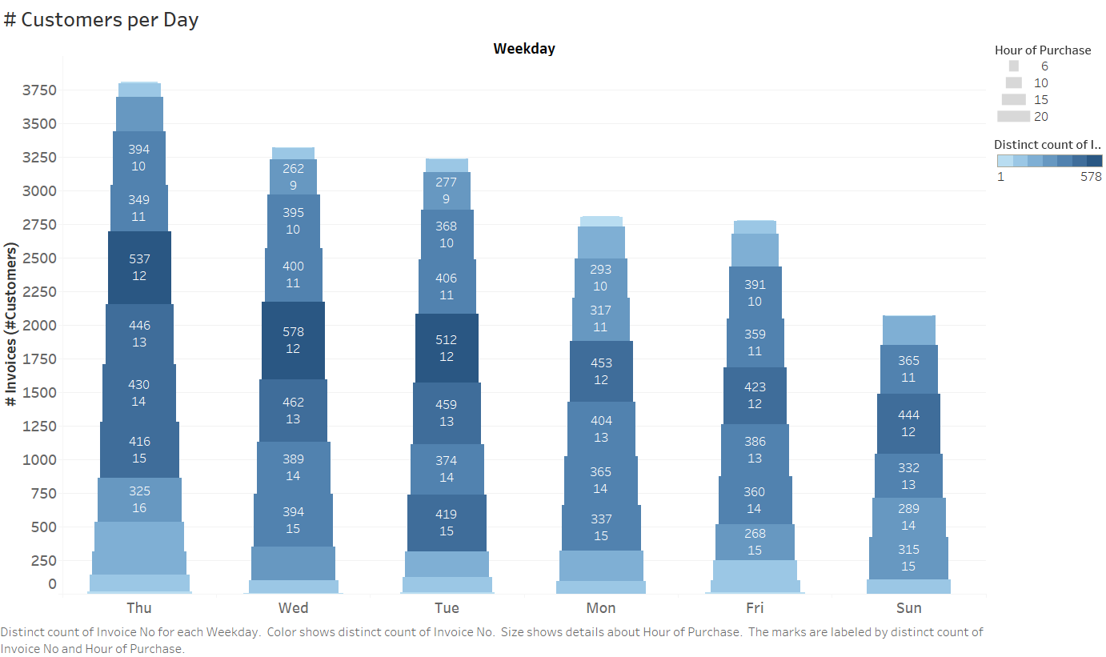
Analysis on United Kingdom
In the above heatmap, we observe that maximum customers are during 11 am to 3 pm. Sunday has the minimum customers, so may be an offer on Sunday might boost sales on that day.

Slide 12
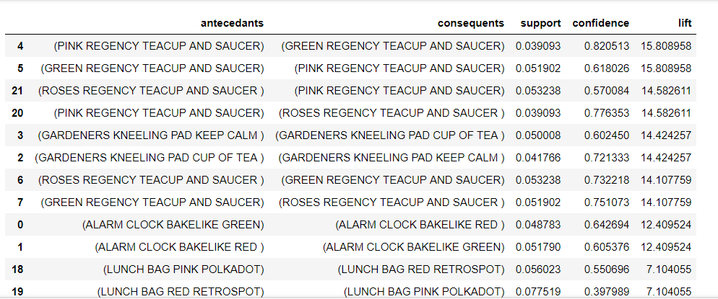
Analysis on United Kingdom
Market Basket Analysis

Slide 13
Analysis on United Kingdom
So for United Kingdom, the data shows that there is again a trend of purchasing different colored teacup and saucers together.
This makes sense since people would like to buy a set of different colors of teacups.
Moreover, British people love tea, so I would recommend to pair the different colored teacups together and bundle them.
As we see in the above rules, consider the RuleID 2, the support is high of 5.1% [934 times purchased together]. Also other colored teacups have good support as well as confidence. So we can assume that bundling would do good.

Slide 14
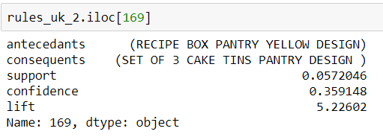
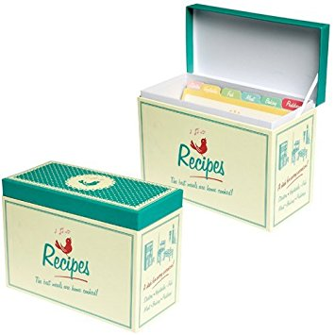
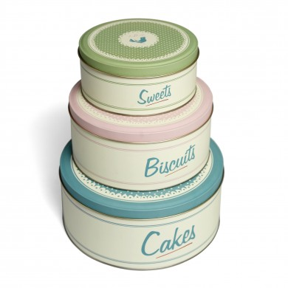
Analysis on United Kingdom
Another insight from the data. We see the rule:
[RECIPE BOX PANTRY YELLOW DESIGN] => [SET OF 3 CAKE TINS PANTRY DESIGN]
Support = 5.72% [1029 times purchased together]
Confidence = 35%
Lift = 5.22 [Greater than 1 shows statistically dependent in a positive way]

Slide 15
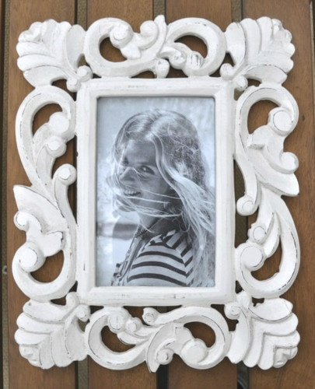
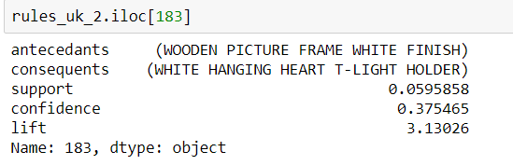
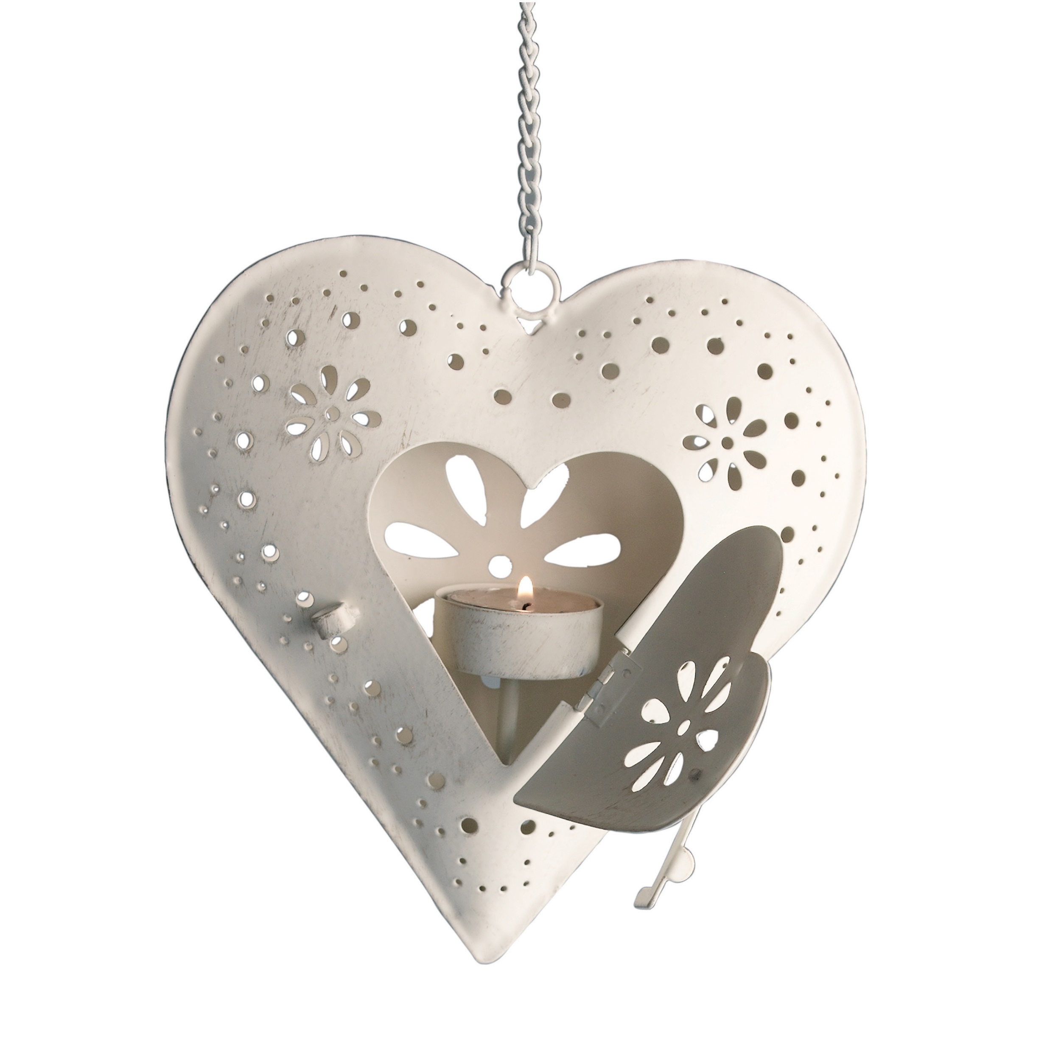
Analysis on United Kingdom
Another insight from the data. We see the rule:
[WOODEN PICTURE FRAME WHITE FINISH] => [WHITE HANGING HEART T-LIGHT HOLDER]
Support = 5.95% ~~ 6.0 % [1083 times purchased together]
Confidence = 37%
Lift = 3.13 [Greater thn 1 shows statistically dependent in a positive way]

Slide 16
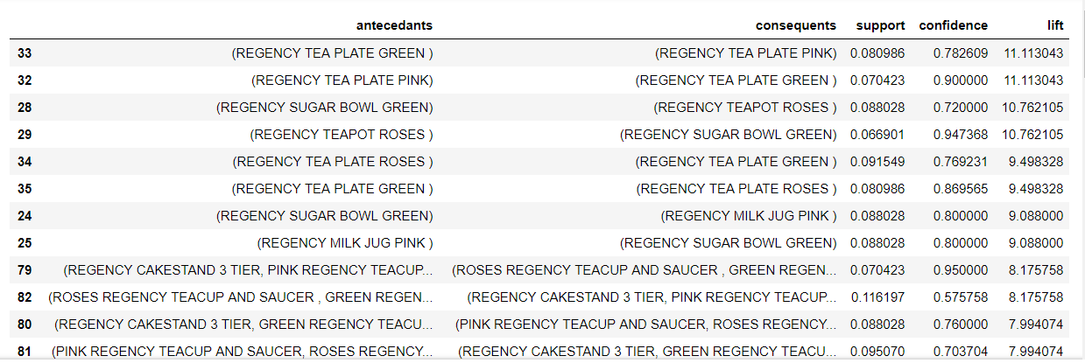
Analysis on Ireland
Market Basket Analysis

Slide 17
Analysis on Ireland
Two rules that are found a little interesting are:
TEAPOT => SUGAR BOWL
SUPPORT = 0.065 (19 invoices contained both the items out of 288)
CONFIDENCE = 0.947 (94.73% chances that once TEAPOT is purchased, customers also buy SUGAR BOWL)
LIFT = 10.91 (Much greater than 1 indicates that the two products are correlated in a positive way and statistically dependent)
MILK JUG => SUGAR BOWL
SUPPORT = 0.086 ( Almost 25 invoices contained both the items out of 288.
CONFIDENCE = 0.80 (80.00% chances that once MILK JUG is purchased, customers also buy SUGAR BOWL)
LIFT = 10.91 (Much greater than 1 indicates that the two products are correlated in a positive way and statistically dependent)

